Slide 1
RangeNet++
Fast and Accurate LiDAR Semantic Segmentation
IROS 2019
史成章 2020.09.17

Slide 2
SqueezeSeg V1, V2
(i) The projection needs to be extended to include the full LiDAR scan, since the SqueezeSeg framework only uses the frontal 90 degrees of the scan, where the objects of the original KITTI dataset labels are annotated by bounding boxes.
(ii) The SqueezeNet backbone is not descriptive enough to infer all the 19 semantic classes provided by our dataset (SemanticKITTI).
(ii) We replace the CRF, which operates in the image domain by an efficient, GPU-based nearest neighbor search acting directly on the full, un-ordered point cloud.

Slide 3
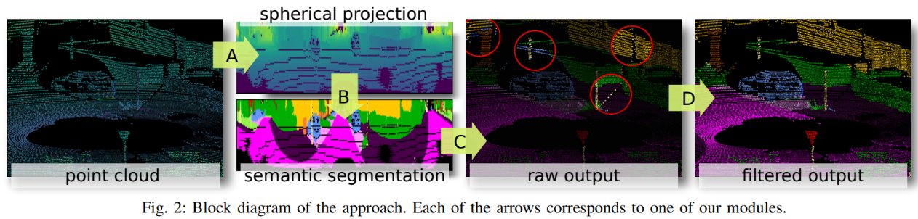
A. Range Image Point Cloud Proxy Representation
B. Fully Convolutional Semantic Segmentation
C. Point Cloud Reconstruction from Range Image
D. Efficient Point Cloud Post-processing

Slide 4
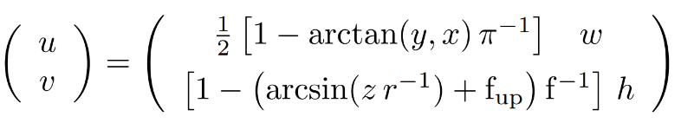
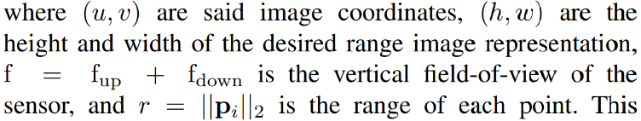
A. Range Image Point Cloud Proxy Representation
for each p_{i} , its range r, its x, y, and z coordinates, and its remission, are stored in the image, creating a [5 × h × w] tensor.
w = 2048, 1024, 512 h = 64

Slide 5
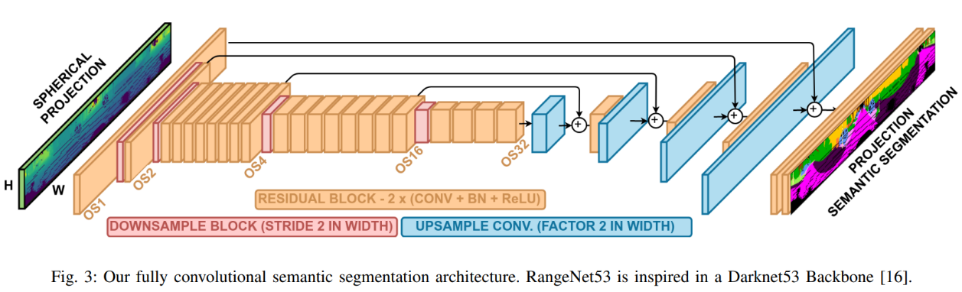
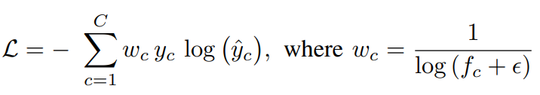

B. Fully Convolutional Semantic Segmentation

Slide 6
C. Point Cloud Reconstruction from Range Image
P1
P2
P3
……
Pn
(u,v)
130000 points per scan → [64 × 2048] 32768 points

Slide 7
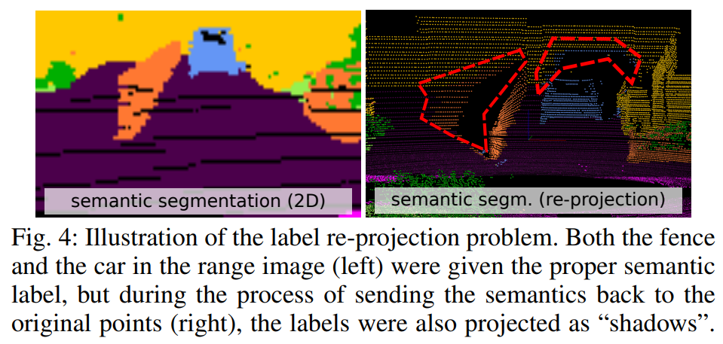
D. Efficient Point Cloud Post-processing

Slide 8
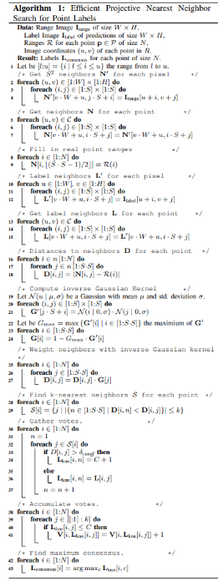
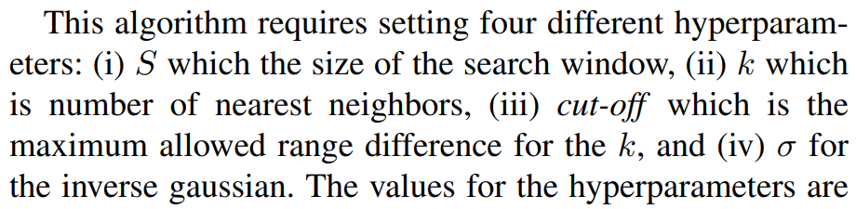
D. Efficient Point Cloud Post-processing

Slide 9
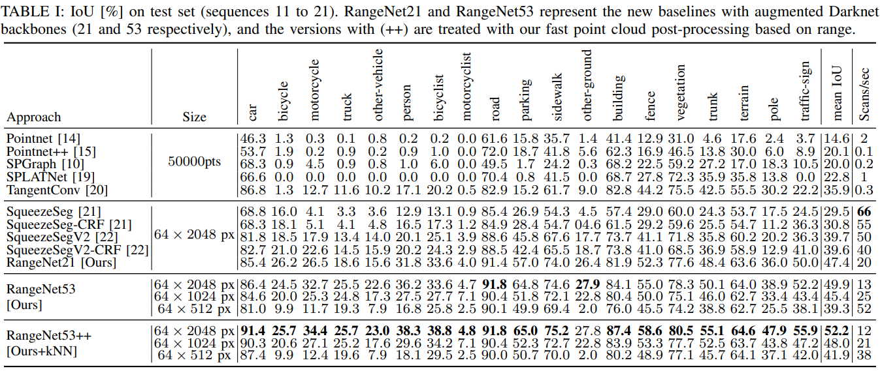
A. Performance of RangeNet++ w.r.t. State-of-the-art

Slide 10
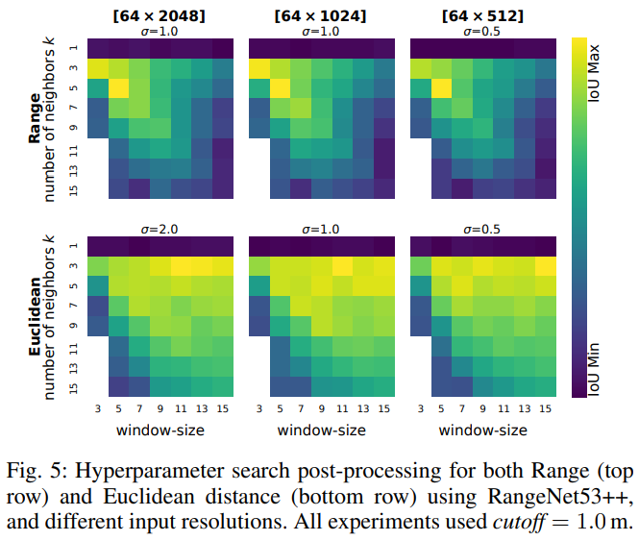
B. Ablation Studies

Slide 11
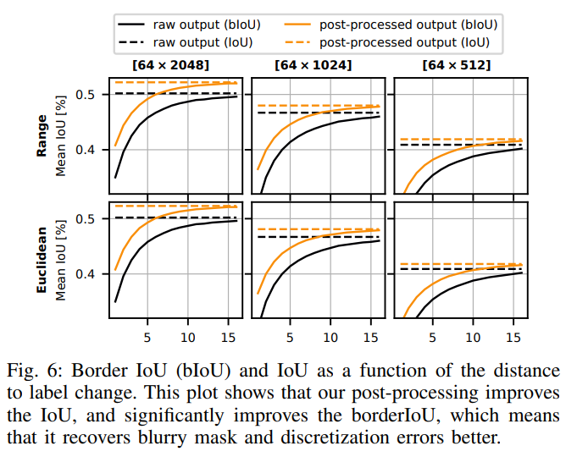
C. Post-Processing Influence

Slide 12
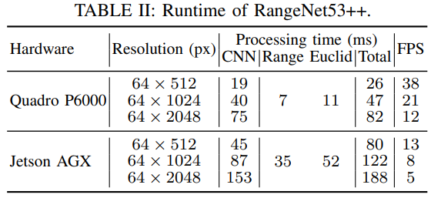
D. Runtime

Slide 13
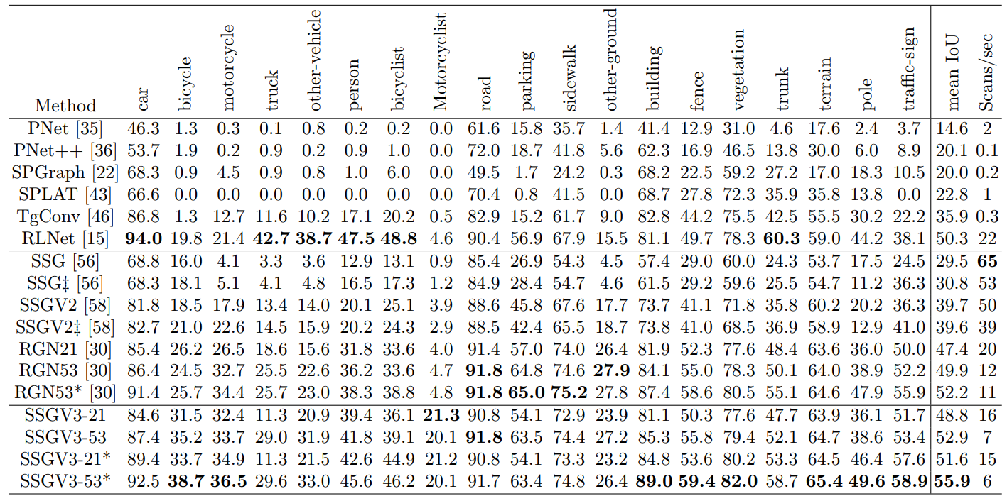
SqueezeSeg V3 ECCV 2020
Spatially-Adaptive Convolution (SAC)

